Slide 1
Development Process and Third Party Test Results of a Coriolis Mass Flow Meter with Superior Density Performance
A. Rieder, H. Zhu, M. Wiesmann
Endress+Hauser Flowtec AG, Am Lohmühlbach 12, 85356 Freising, Germany

Slide 2
Overview
Introduction
Flow Meter
Sensitivities and accuracies
Process influences
Fluid Properties
Environmental and installation effects
Conclusion

Slide 3
Introduction
Additionally to mass flow multi-variable Coriolis mass flow meters also determine temperature and density
Precise density measurement performance under real world process conditions is important for ...
Volumetric custody transfer and meter proving in the Oil & Gas industry
High end concentration measurement in Food & Beverage industry
And in general density is a key indicator of the process fluid quality in all industries

Slide 4
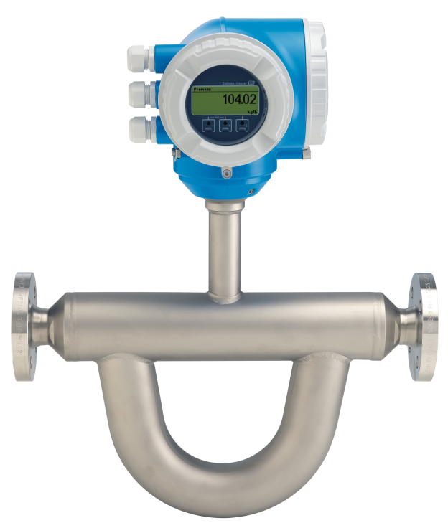
Flow Meter - Design
Coriolis mass flow meter Proline 300 Promass Q
Light weight, compact and drainable
Four different line sizes from 1” to 4”
All industry standard process connections
All standard outputs and communication protocols
Process temperature range -196°C … 205°C
Process pressure range 0 bar … 100 bar
Secondary safety containment

Slide 5
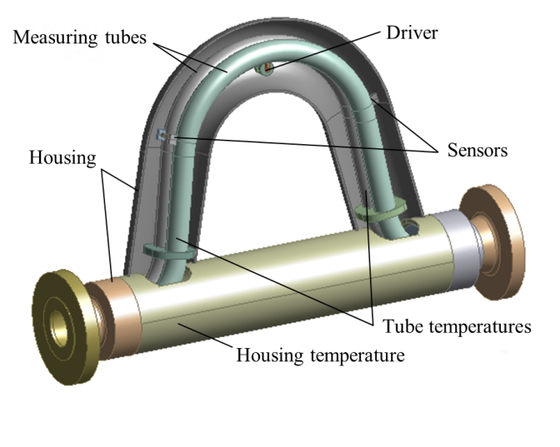
Flow Meter – Internal Structure
Two parallel and bent measuring tubes
Connected via flow splitters to process line
Coupling elements at inlet and outlet define oscillation length of working mode
Electro-dynamic driver at the tube center generates harmonic tube vibration at resonance frequency and constant amplitude
Two electro-dynamic sensors at tube inlet and outlet detect tube vibration
Temperature sensors at measuring tube and housing

Slide 6
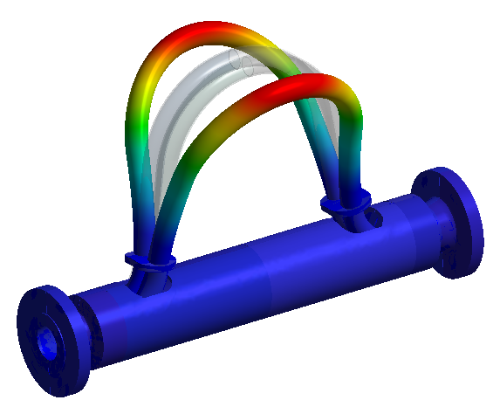
Flow Meter – Working Principle
Both tubes vibrate in opposite directions so system is balanced
Equivalent to a tuning fork energy is conserved in oscillator
Fluid density ρ is derived from raw resonance frequency $f_{r}$
$f=f_{r}(p,v,γ)$
$ρ_{r}=C_{0}(T_{m})+C_{1}\left(T_{m}, T_{h}\right) f^{−2}$
$ρ=ρ_{r}(η,c)$

Slide 7
Sensitivities and accuracies
Process influences
Fluid temperature
Process pressure
Flow velocity
Fluid properties
Fluid density
Fluid viscosity
Fluid compressibility and entrained gas
Corrosion, abrasion and coating
Environmental and installation effects
Environmental temperature and radiation
External forces and vibrations
Meter orientation

Slide 8
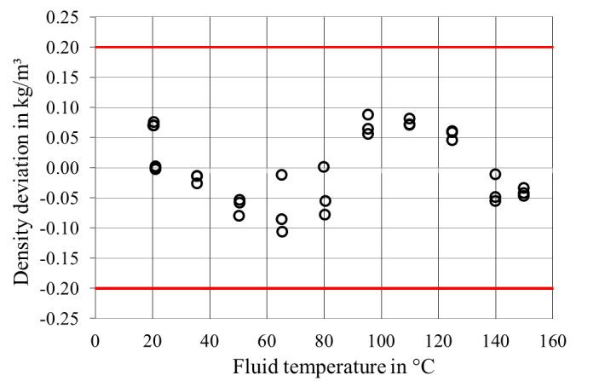
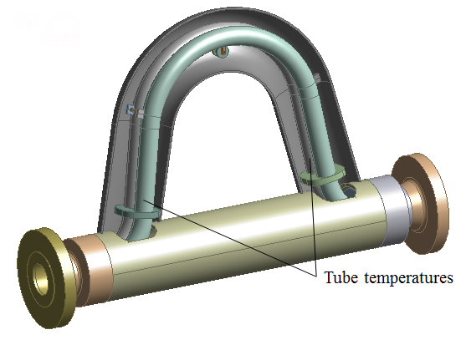
Sensitivities and accuracies - Process influences - Fluid temperature $T_{m}$
Compensate Young's Modulus
Two PT1000 at inlet and outlet
To cover temperature gradients
To provide redundancy

Slide 9
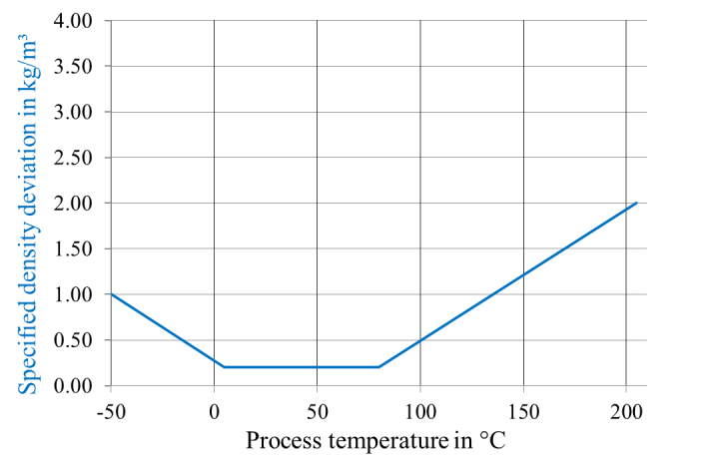
Sensitivities and accuracies - Process influences - Fluid temperature $T_{m}$
Temperature specification

Slide 10
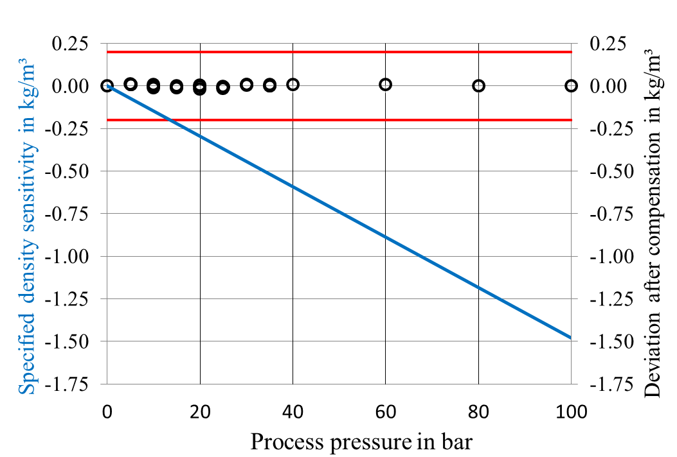
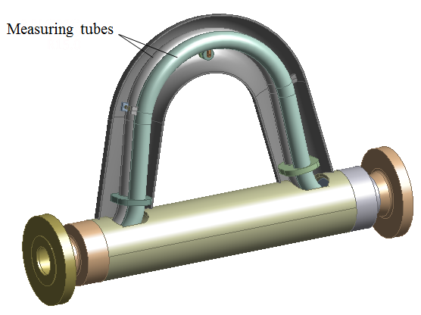
Sensitivities and accuracies - Process influences - Process pressure $p$
Optimized tube shape and braces
Hydro formed tubes
Small residuum -0.015 kg/m³/bar
Repeatable and linear sensitivity

Slide 11
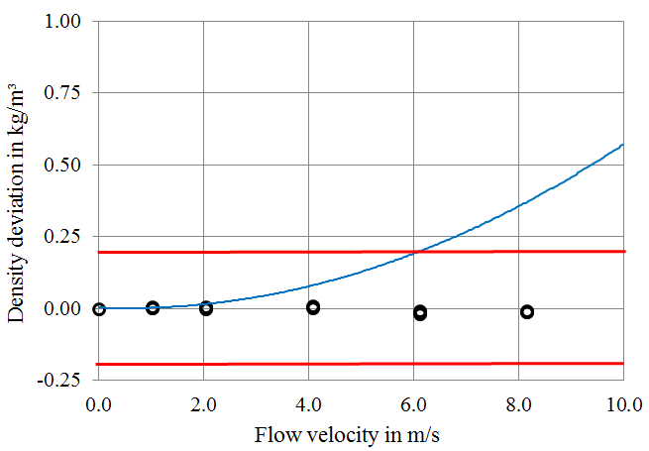
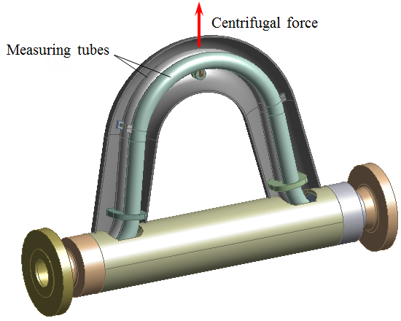
Sensitivities and accuracies - Process influences - Flow velocity $v$
Flow velocity $v$ generates centrifugal force
Stiffening effect of tube is compensated

Slide 12
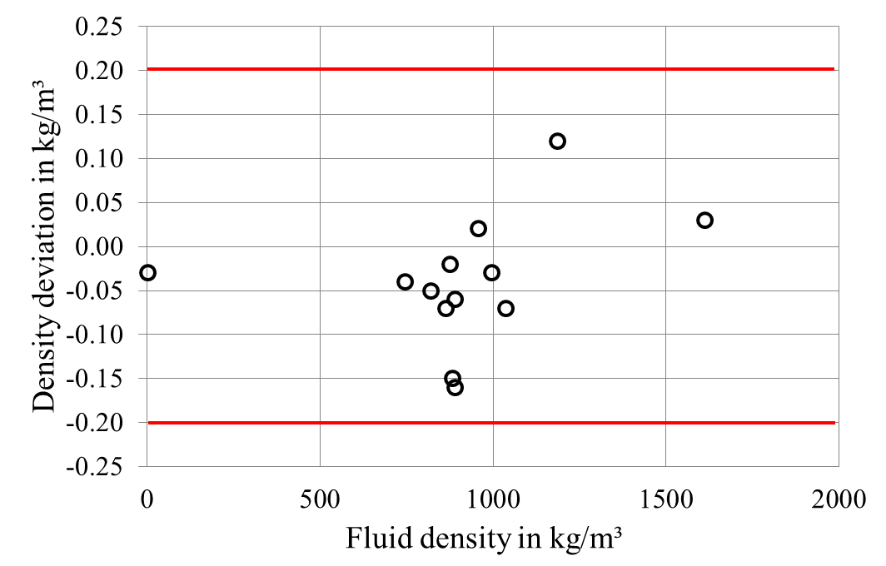
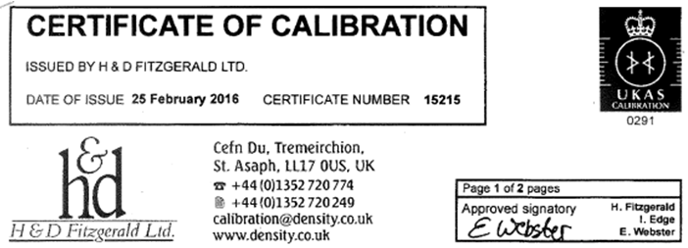
Sensitivities and accuracies – Fluid properties - Fluid density $ρ$
Linearity across fluid density
11 different fluids at 25°C tested
Densities of air and liquids
from 745 kg/m³ to 1612 kg/m³
UKAS certificate issued by
H&D Fitzgerald Ltd.

Slide 13
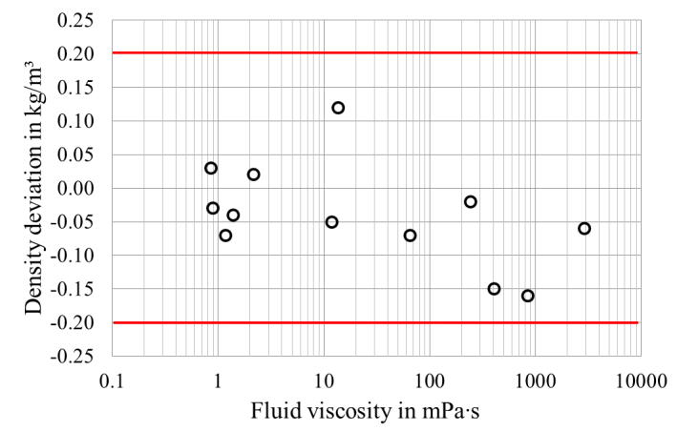
Sensitivities and accuracies – Fluid properties - Fluid viscosity $η$
Compensated viscosity effect
11 different fluids at 25°C tested
Viscosities up to 2885 mPa∙s
UKAS certificate issued by
H&D Fitzgerald Ltd.

Slide 14
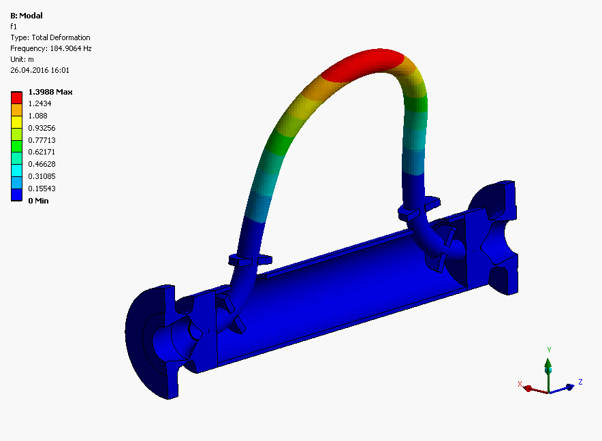
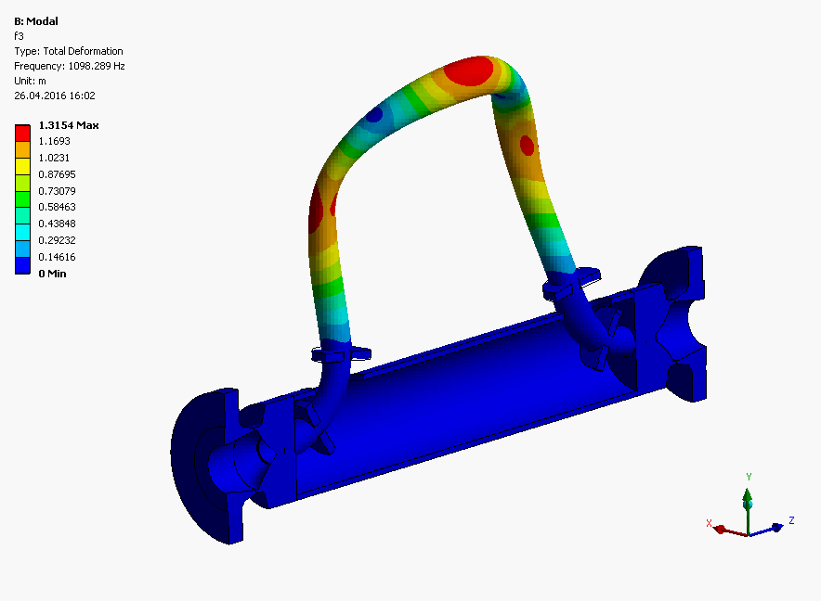
Sensitivities and accuracies – Fluid properties – Entrained gas
Entrained gas in liquid rises compressibility of the mixture significantly
Higher compressibility increases mixture amplitude and thus causes positive density deviation
Using simultaneously driven higher order mode, error compensation called MFT is implemented
Working mode
Higher order mode

Slide 15
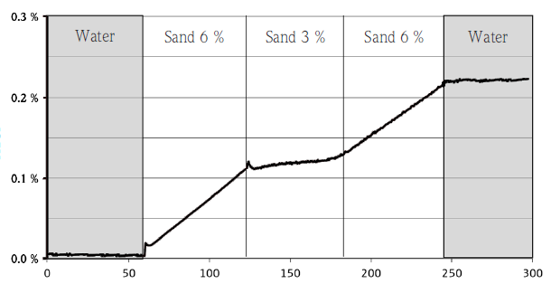
Sensitivities and accuracies – Fluid properties - Corrosion, abrasion and coating
Corrosion, abrasion and coating can cause wrong density reading
New Heartbeat TechnologyTM helps to detect these effects
Abrasion
Heartbeat Sensorintegrity
Time in h

Slide 16
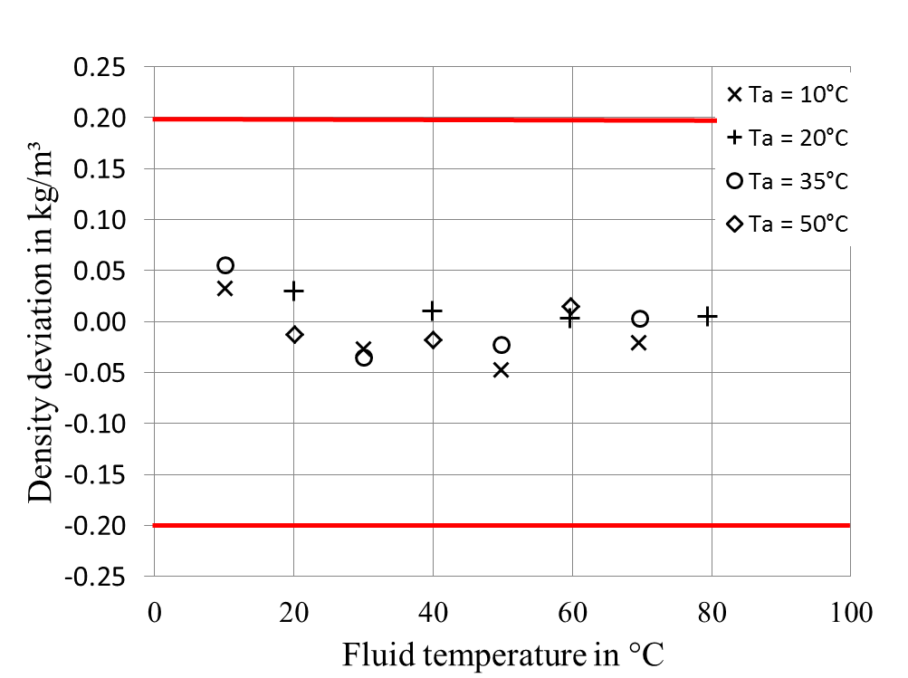
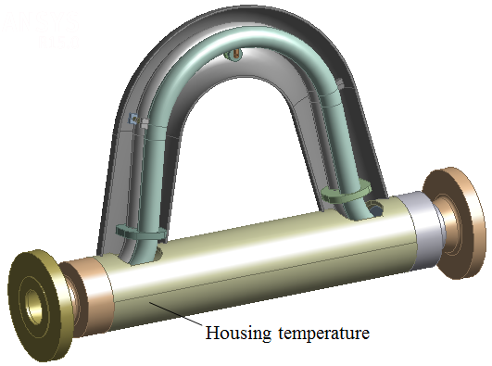
Sensitivities and accuracies – Environmental effects – Temperature and radiation
Environmental temperature and sunshine often distort density measurement
Tube shape and optimal position of housing temperature sensor minimize this influences

Slide 17
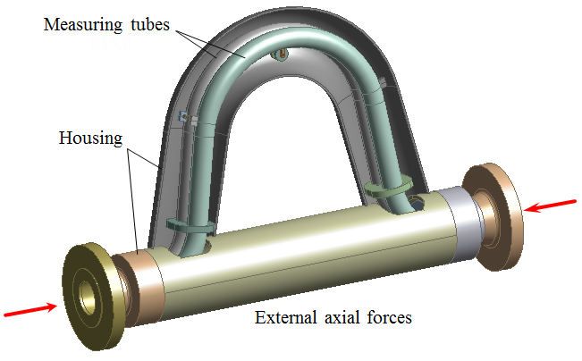
Sensitivities and accuracies – Environmental effects - Forces and vibrations
Tube shape and housing stiffness optimized
Overall meter size and weight still compact and light
Moderate working frequency offers immunity against the influence of external vibrations which are typically at low frequencies

Slide 18
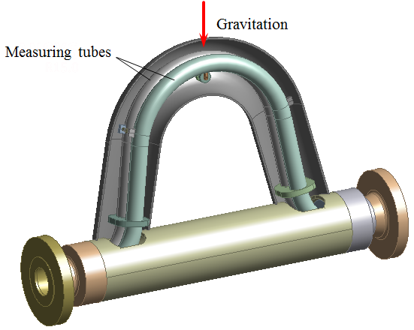
Sensitivities and accuracies – Environmental effects - Meter orientation
Effect depending on meter orientation with respect to the earth’s gravity
Tube mass give rise to tension or compression along straight measuring tube segments
Changing resonance frequency and density reading
Automatic compensation by giving installation angle

Slide 19
Conclusion
New type of Coriolis mass flow meter E+H Promass Q was presented
During development process FEM and CFD simulation in symbiosis with experimental approach have been used
Meter was tested both internally as well as third party across a broad range of process parameters, fluid properties as well as environmental and installation conditions
Meter delivers robust fluid density measurement in the field within ±0.2 kg/m³

